Slide 1
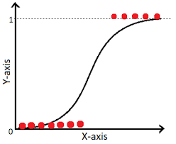
Logistic Regression
14
- Dr. Sifat Momen (SfM1)

Slide 2
Learning goals
After this presentation, you should be able to
Understand how linear regression is used to solve classification problem
Understand the underlying concept of logistic regression in the realms of binary classification problem
The limitation of linear regression to solving classification problems and how are these problems resolved in logistic regression
The OVR technique to extend the solution to multi-class classification problem

Slide 3



Classification
Email: Spam / Not Spam?
Online Transactions: Fraudulent (Yes / No)?
Tumor: Malignant / Benign ?
0: “Negative Class” (e.g., benign tumor)
1: “Positive Class” (e.g., malignant tumor)

Slide 4
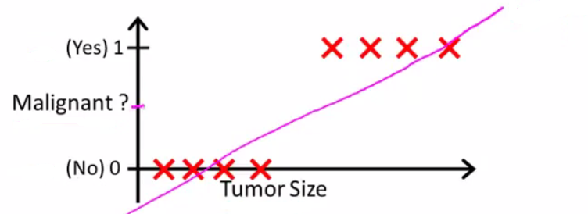
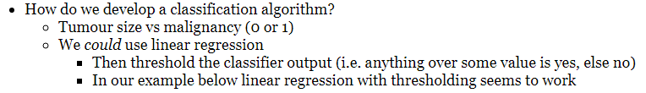
(Yes) 1
Malignant ?
(No) 0
Tumor Size
Tumor Size

Slide 5
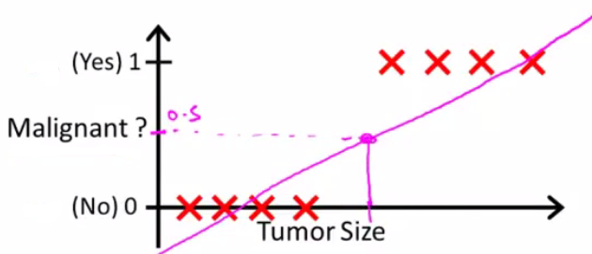

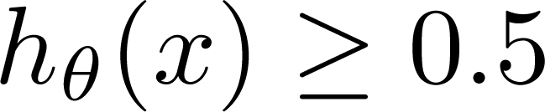
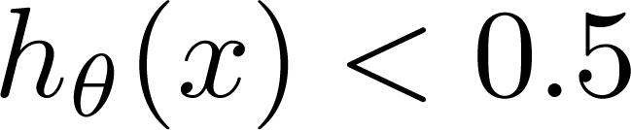
Threshold classifier output at 0.5:
If , predict “y = 1”
If , predict “y = 0”

Slide 6
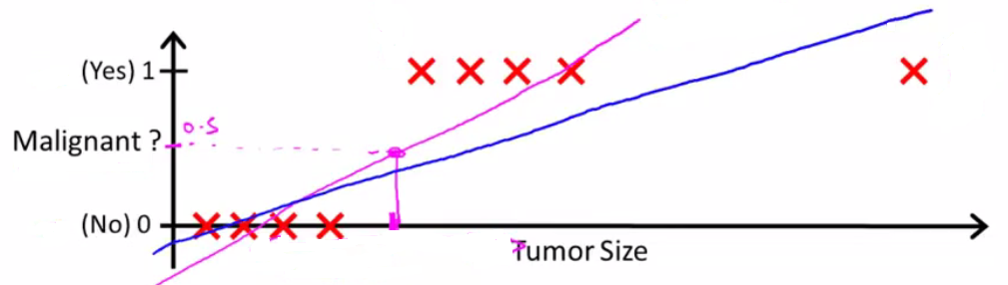
(Yes) 1
Malignant ?
(No) 0
Tumor Size
Tumor Size

Slide 7
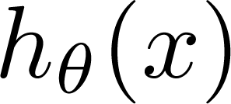
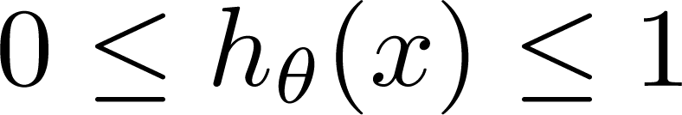
Classification: y = 0 or 1
can be > 1 or < 0
Logistic Regression:

Slide 8

Hypothesis Representation
Logistic
Regression
Machine Learning

Slide 9
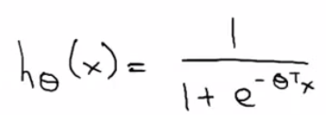
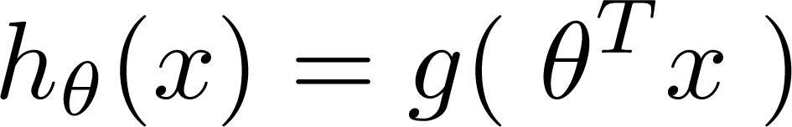
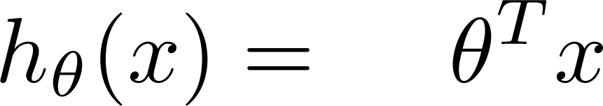
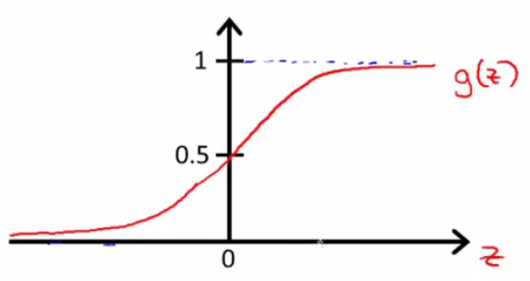
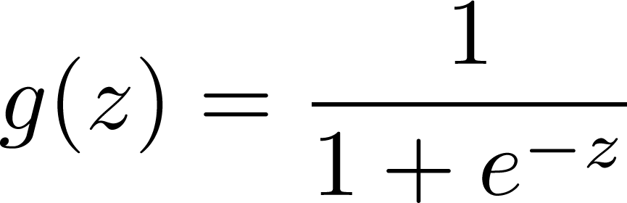
Logistic Regression Model
Want
1
0.5
Sigmoid function
Logistic function
0

Slide 10
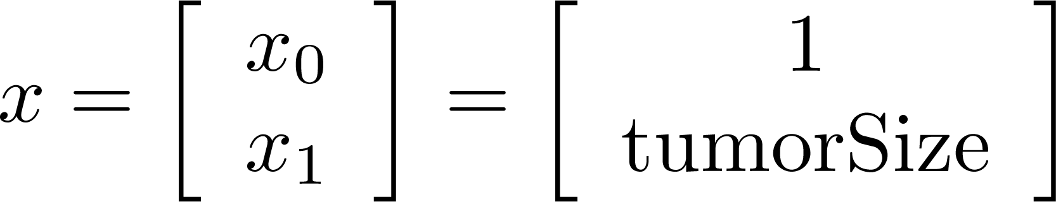
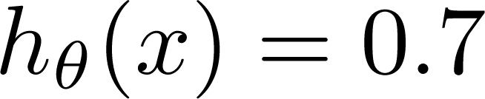
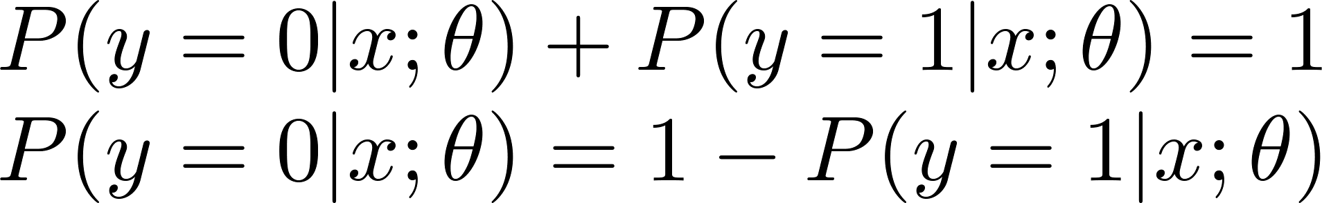
Interpretation of Hypothesis Output
= estimated probability that y = 1 on input x
Example: If
Tell patient that 70% chance of tumor being malignant
“probability that y = 1, given x,
parameterized by ”

Slide 11
Decision boundary
Logistic
Regression
Machine Learning

Slide 12
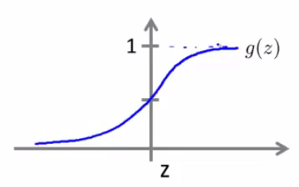

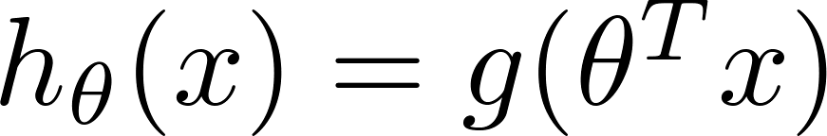
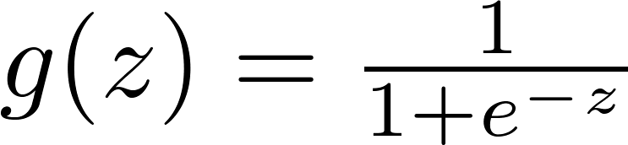

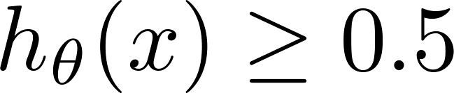

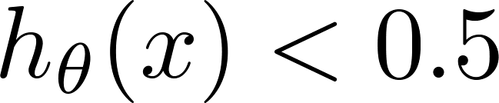
Logistic regression
1
z
Suppose predict “ “ if
predict “ “ if

Slide 13

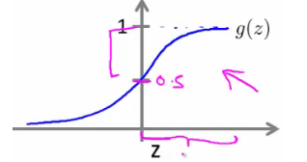
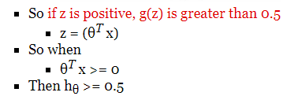

Slide 14
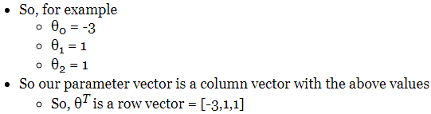
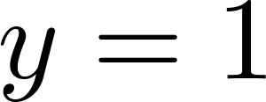

Decision Boundary
x₂
3
2
1
1
2
3
x₁
Predict “ “ if

Slide 15
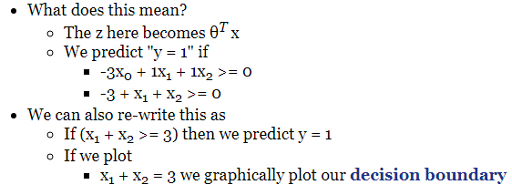
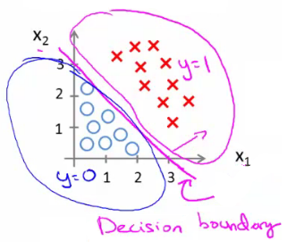
Decision Boundary
x₂
3
2
1
1
2
3
x₁
Predict “ “ if

Slide 16
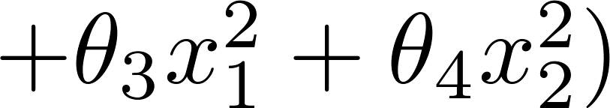
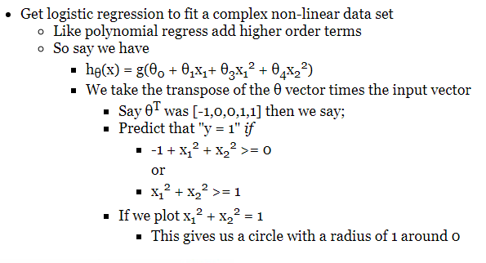
Non-linear decision boundaries
x₂
1
x₁
-1
1
-1
x₂

Slide 17
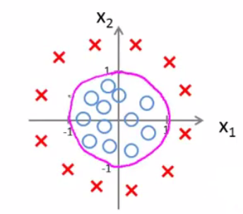
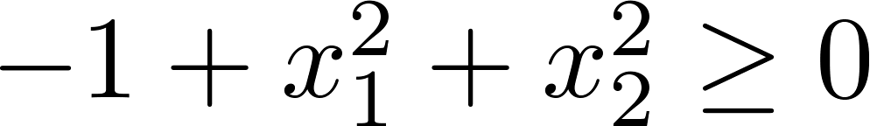
Non-linear decision boundaries
x₂
1
x₁
-1
1
-1
Predict “ “ if
x₂

Slide 18
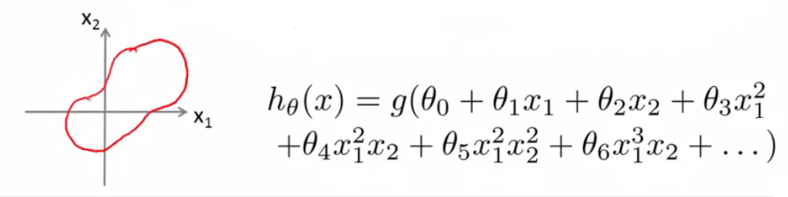
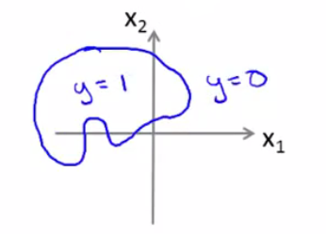
Non-linear decision boundaries

Slide 19
Cost function
Logistic
Regression
Machine Learning

Slide 20
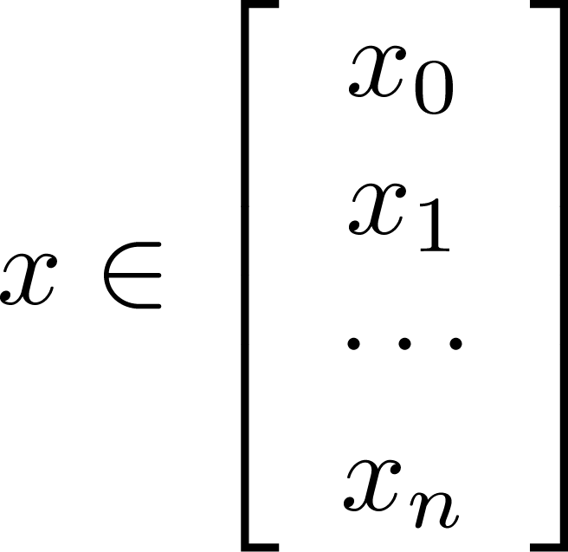
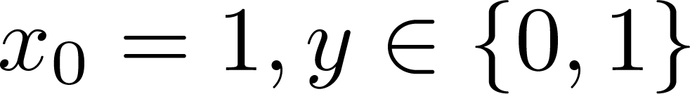
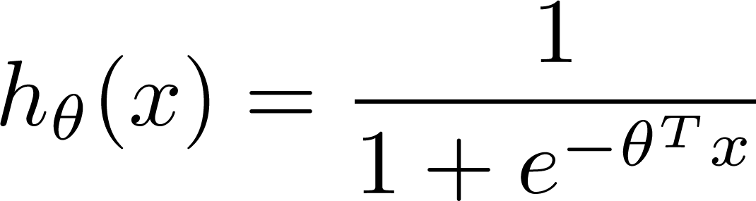

Training set:
m examples
How to choose parameters ?

Slide 21
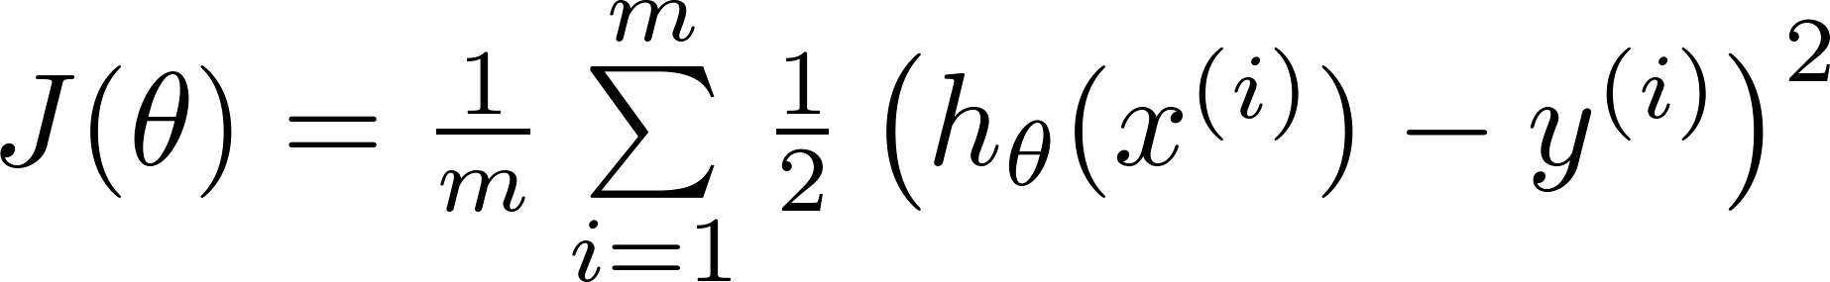
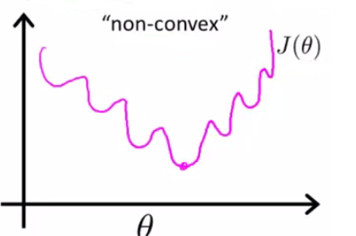
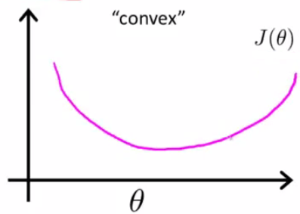

Cost function
Linear regression:
“non-convex”
“convex”

Slide 22
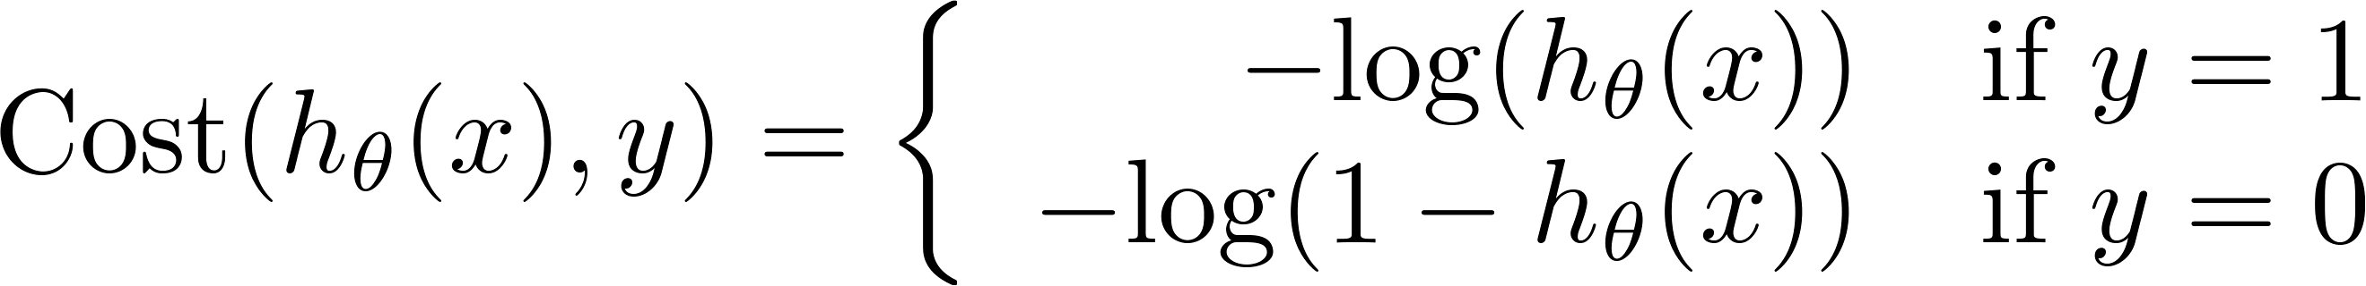
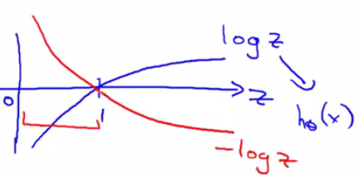
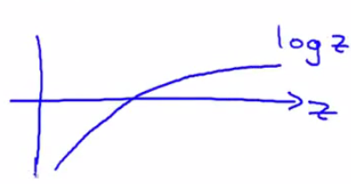
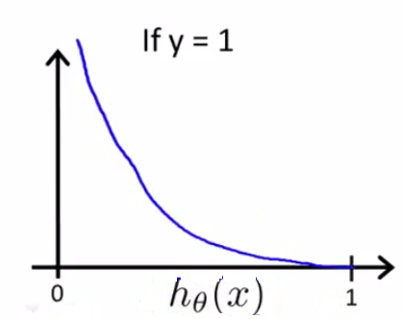
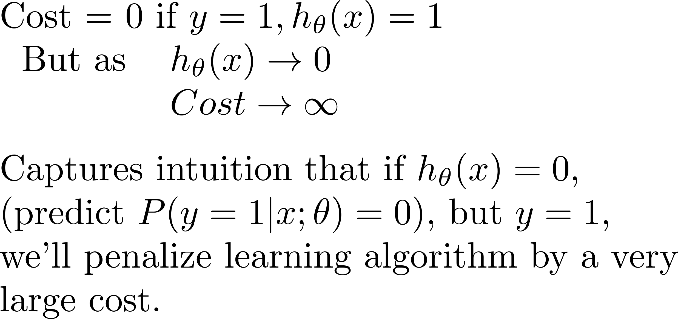
Logistic regression cost function
If y = 1
0
1

Slide 23
Logistic regression cost function
If y = 0
0
1

Slide 24
Simplified cost function and gradient descent
Logistic
Regression
Machine Learning

Slide 25
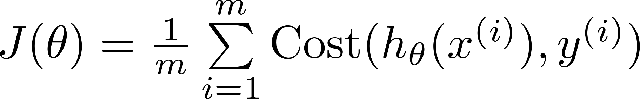

Logistic regression cost function

Slide 26

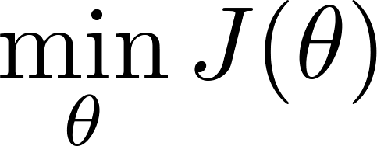

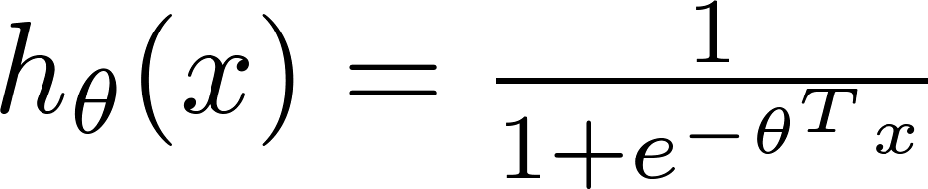
Logistic regression cost function
To fit parameters :
To make a prediction given new :
Output

Slide 27


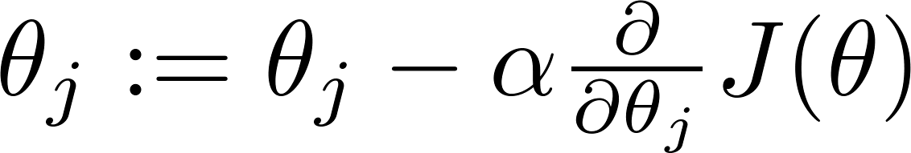


Gradient Descent
Want :
Repeat
(simultaneously update all )

Slide 28
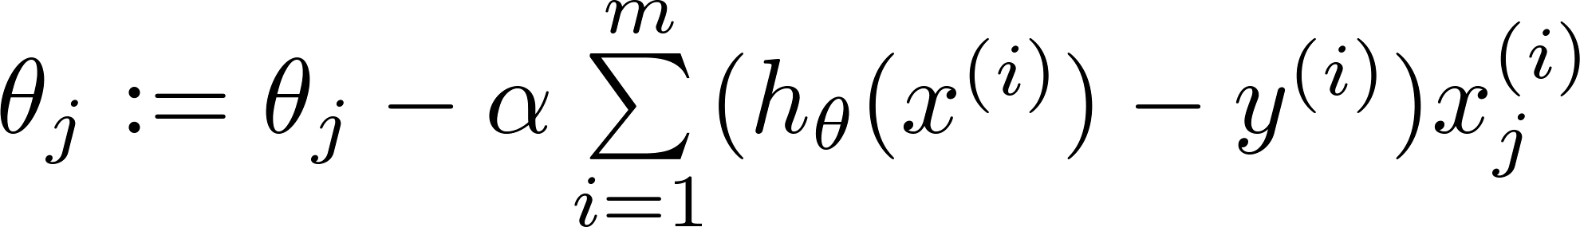
Gradient Descent
Want :
Repeat
(simultaneously update all )
Algorithm looks identical to linear regression!

Slide 29
Multi-class classification: One-vs-all
Logistic
Regression
Machine Learning

Slide 30
Multiclass classification
Email foldering/tagging: Work, Friends, Family, Hobby
Medical diagrams: Not ill, Cold, Flu
Weather: Sunny, Cloudy, Rain, Snow

Slide 31
Binary classification:
Multi-class classification:
x₂
x₂
x₁
x₁

Slide 32


x₂
One-vs-all (one-vs-rest):
x₁
x₂
x₂
x₁
x₁
Class 1:
Class 2:
Class 3:
x₂
x₁

Slide 33




One-vs-all
Train a logistic regression classifier for each class to predict the probability that .
On a new input , to make a prediction, pick the class that maximizes

Slide 34
Sklearn Implementation
https://scikit-learn.org/stable/modules/generated/sklearn.linear_model.LogisticRegression.html

